Slide 1
Statistical Modeling Explained in Python
Introduction to Hypothesis Testing
Terminologies( Null, Alternative)
P-Value
Test Statistics
Critical Value
Level of Significant
Shahzaib Hamid
AI Sciences Instructor

Slide 2
Module Overview
Terminologies-1
Methods
Critical Values
Null
Alternative
Test Statistics
P-Value
Two Sided Test
Left Tail Test
Right Tail Test

Slide 3

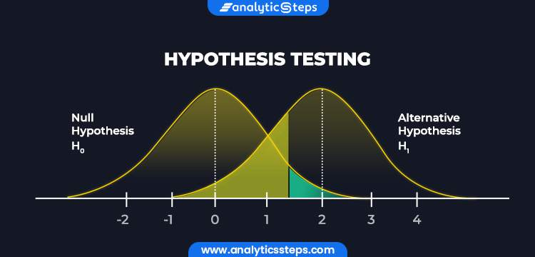
Hypothesis Testing
Summary Statistics

Slide 4

Overview of Hypothesis Testing
Test the assumptions made regarding a population parameter
Depends upon the nature of data
Assess plausibility of a hypothesis

Slide 5
Terminologies of Hypothesis Testing
Null Hypothesis
Alternative Hypothesis
Level of Significance
Critical Value
Test Statistics
p-value
Terminologies

Slide 6
Null Hypothesis
H₀, is the statement about the population parameter that is assumed to be true unless there is convincing evidence to the contrary.
Example:
A publisher of college textbooks claims that the average price of all hardbound college textbooks is $127.50. A student group believes that the actual mean is higher and wishes to test their belief. State the relevant null and alternative hypotheses.
Two Conditions
Reject H₀ (and therefore accept H_{a})
Fail to reject H₀ (and therefore fail to accept H_{a})
Solution:
The default option is to accept the publisher’s claim unless there is compelling evidence to the contrary. Thus, the null hypothesis is H₀:μ=127.50. Since the student group thinks that the average textbook price is greater than the publisher’s figure, the alternative hypothesis in this situation is H_{a}: μ>127.50.

Slide 7
Alternative Hypothesis
H_{a}, is a statement about the population parameter that is contradictory to the null hypothesis and is accepted as true only if there is convincing evidence in favor of it.
Example:
The recipe for a bakery item is designed to result in a product that contains 8 grams of fat per serving. The quality control department samples the product periodically to insure that the production process is working as designed. State the relevant null and alternative hypotheses.
Two Conditions
Reject H₀ (and therefore accept H_{a})
Fail to reject H₀ (and therefore fail to accept H_{a})
Solution:
The default option is to assume that the product contains the amount of fat it was formulated to contain unless there is compelling evidence to the contrary. Thus, the null hypothesis is H₀:μ=8.0. Since to contain either more fat than desired or to contain less fat than desired are both an indication of a faulty production process, the alternative hypothesis in this situation is that the mean is different from 8.0, so H_{a}:μ≠8.0.

Slide 8

Test Statistics
The test statistic is a number calculated from a statistical test of a hypothesis.
How relevant is data with expected under null hypothesis
Used to calculate p-value
T-statistics = $\frac{sample proportion −total sample}{standard daviation}$

Slide 9
p-value
Probability of the test statistic being at least as extreme as the one observed given that the null hypothesis is true.
Help to support or reject the null hypothesis
A small p-value is an indication that the null hypothesis is false.
A small p (Smaller), reject the null hypothesis. Alternate hypothesis is strong.
A large p (Larger), alternate hypothesis is weak, do not reject the null hypothesis.
Example:
A p value of 0.0254 is 2.54%.
This means there is a 2.54% chance your results could be random (i.e. happened by chance).
On the other hand, a large p-value of .9 (90%) means your results have a 90% probability of being completely random and not due to anything in your experiment.

Slide 10
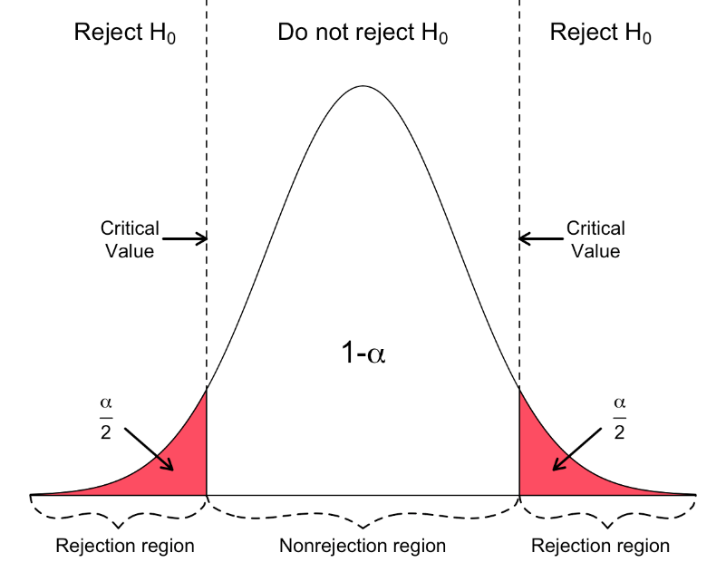
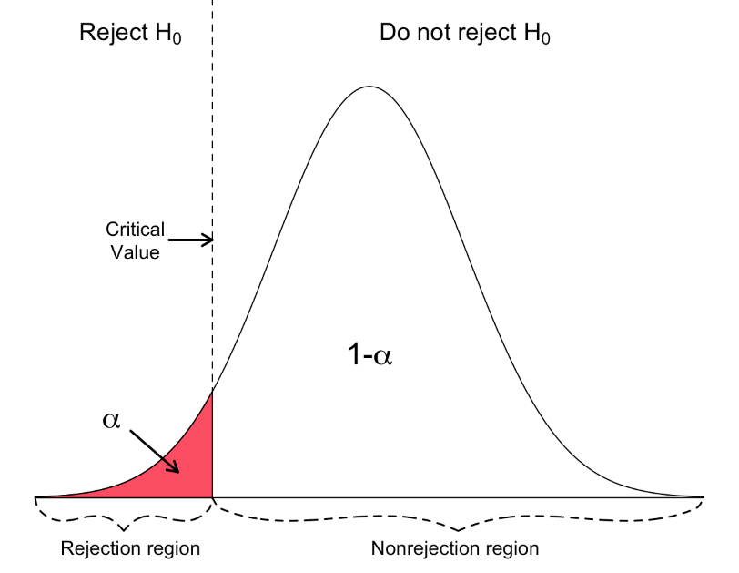
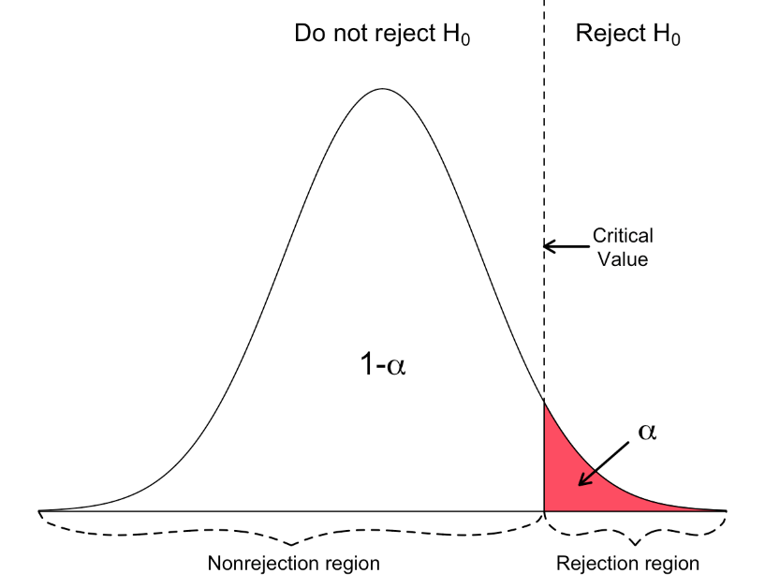
Critical Value
Two-Sided Test
Left-Tailed Test
Right-Tailed Test

Slide 11
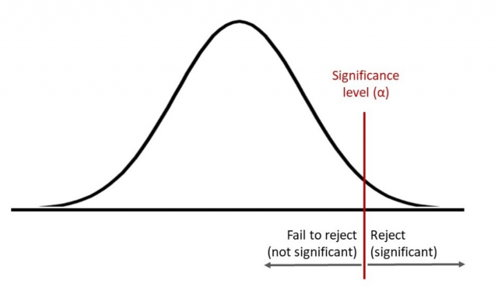
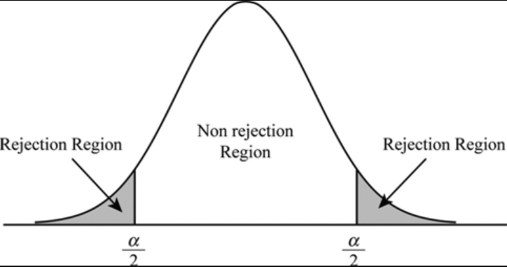
Level of Significance
Also called Alpha level
A threshold, which reject of accept any hypothesis

Slide 12
Case Study -1
Compared the smoking cessation rates for smokers randomly assigned to use a nicotine patch versus a placebo patch.
Null hypothesis
The proportion of smokers in the population who would quit smoking using a nicotine patch and a placebo patch are the same.
Alternative hypothesis
The proportion of smokers in the population who would quit smoking using a nicotine patch is higher than the proportion who would quit using a placebo patch
Test Statistics
Higher smoking cessation rates were observed in the active nicotine patch group at 8 weeks (46.7% vs 20%) (P < .001) and at 1 year (27.5% vs 14.2%) (P = .011). (Hurt et al., 1994, p. 595)
Conclusion
p-values are quite small: less than 0.001 for difference after 8 weeks and equal to 0.011 for difference after a year. Therefore, rates of quitting are significantly higher using a nicotine patch than using a placebo patch after 8 weeks and after 1 year.

Slide 13
Case Study -2
On May 16, 1994, Newsweek reported the results of a public opinion poll that asked:
“From everything you know about Bill Clinton, does he have the honesty and integrity you expect in a president?”
Poll surveyed 518 adults and 233, or 0.45 of them
(clearly less than half),
answered yes.
Could Clinton’s adversaries conclude from this that only a minority (less than half) of the population of Americans thought Clinton had the honesty and integrity to be president?

Slide 14
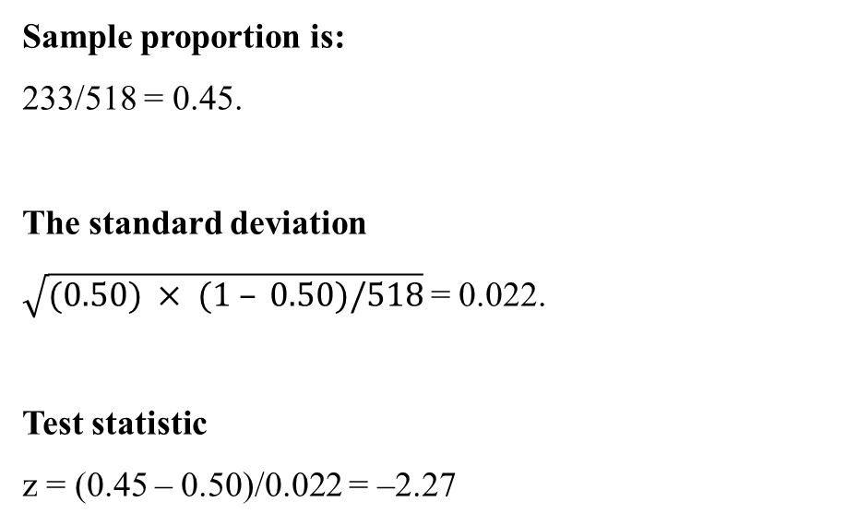
Case Study -2
Determine the null and alternative hypotheses.
Null hypothesis
Collect and summarize data into a test statistic.
There is no clear winning opinion on this issue; the proportions who would answer yes or no are each 0.50.
Sample proportion is:
233/518 = 0.45.
The standard deviation
$\sqrt{(0.50) × (1 – 0.50)/518}$= 0.022.
Test statistic
z = (0.45 – 0.50)/0.022 = –2.27
Alternative hypothesis
Fewer than 0.50, or 50%, of the population would answer yes to this question. The majority do not think Clinton has the honesty and integrity to be president.

Slide 15
Case Study -2
Determine the p-value
Make a decision
Recall the alternative hypothesis was one-sided.
p-value = proportion of bell-shaped curve below –2.27
Exact p-value = 0.0116.
The p-value of 0.0116 is less than 0.05, so we conclude that null hypothesis is true about the President.

Slide 16
Alternate Method
We can also carry out hypothesis testing using these concepts
PDF
norm.pdf(x, loc=0, scale=1) Probability density function.
CDF
SF
norm.cdf(x, loc=0, scale=1) Cumulative distribution function. (area to the left of x)
norm.sf(x, loc=0, scale=1) Survival function (also defined as 1 - cdf, but sf is sometimes more accurate).
PPF(z critical left)
ISF(z critical right)
norm.ppf(q, loc=0, scale=1) Percent point function (inverse of cdf — percentiles)
norm.isf(q, loc=0, scale=1) Inverse survival function (inverse of sf)
P-value
2*norm.sf(z)

Slide 17
Steps of Hypothesis Testing
Steps
Choose Data
State Hypothesis
Select Test Statistics
Calculate Test Statistics
Statistical Decision

